Slide 1
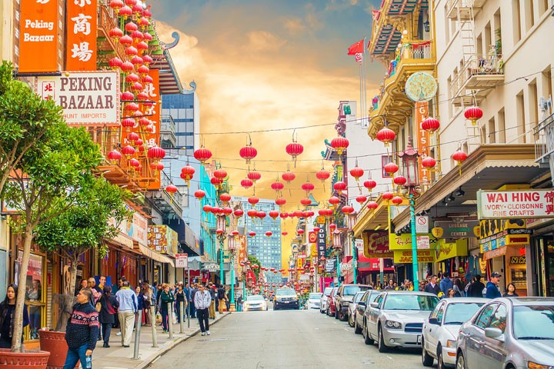
Foodie Network
Your guide to authentic Yelp reviews

Slide 2
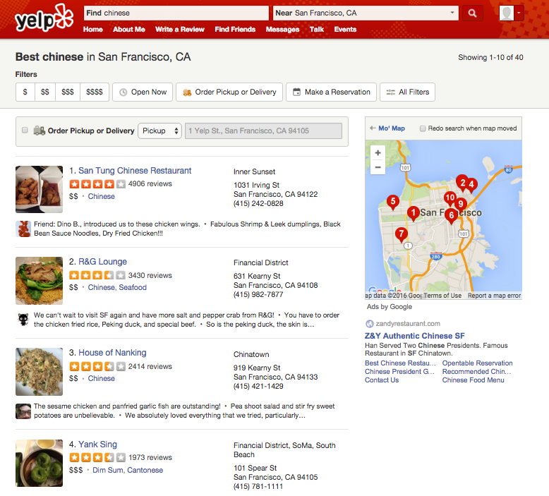
How do I know what is authentic Chinese Food? (or whatever cuisine you like) Yelp is no help.
Thousands of reviews but Yelp only filters the “good reviews”
Notes:
To motivate my project, I start out with an example. Say your me and you often have difficulty finding good Chinese Food (maybe not in San Francisco or LA) where I am from but especially when I am traveling to the Mid-West. BTW, I am not an expert on Chinese food but I do know what tastes good. However it’s a good question because people often wonder the authenticity of Chinese Food and I will be this example throughout my presentation
Goal: Identify restaurants with a strong or weak community of the same cuisines (in this case Chinese)

Slide 3
But … How do you predict Authenticity?
Fidelity to cuisines traditions – few menu options, specialties, local ingredients, no ethnic fusions
Owner, number years in business, clientele, decor
Authenticity varies greatly even within a single country
Especially in today’s global economy, ingredients are shipped trans-continent and fusions are fad
People are idiosyncratic, especially something like taste
Notes:
No shortage of features but not no label to validate results
Maybe I could do a survey of the clientele?
Tend to eat only one type of cuisine
Immigrants rather cook themselves if they could do it better
Yelp is biased towards young yuppies
San Francisco is harder to detect signal vs. rural areas
how many versions of menus they have (languages)
Non-authentic restaurant names – panda, golden, china, dragon, bamboo, fortune, happy, wok, express, golden, palace, take-out, fortune cookies, zodiac place mats
Menu items and names
Harder to tell when restaurants are cuisine fusion
I used big data

Slide 4
Unsupervised Network Model
Within community
Between Community
F
F
F
R
R
F
F
Chinese?
F
F
Italian?
Businesses: ~1,000
Users: ~17,000
Reviews: ~108,000
1. Find initial Communities of Foodies for a Restaurant
2. Identify density of relationships within V.S between communities
3. Identify cuisine relationships
Notes:
Use Community Detection Algorithms to find initial communities (Within community connections)
But then Foodies from one community may also like to eat other restaurants. (Between Community connections)
A restaurant who has a lot of users rating outside of its community is one which is more diverse (or less cohesive)
Then a restaurant who has a high proportion of business inside of its community is more similar
If so, are majority of the cuisines within community Chinese?
Based on a restaurant’s foodies, does restaurant X know what good Y food is?
How similar/ or diverse are Restaurant X’s foodies?

Slide 5


Data Pipeline
Data Collection
Scrape Yelp User & Review Data
Query Yelp API for Business Data
Data Pre-processing
Data Cleaning for Database Insertion
Data Modeling
Build Network Model – Community Detection, Centrality Measures
Compare Model Results to average Yelp Reviews
Deploy Code on Amazon Services
Model Validation/ Evaluation
Evaluate Custom Evaluation Metrics
Visualize Business Case
Build Web-App

Slide 6
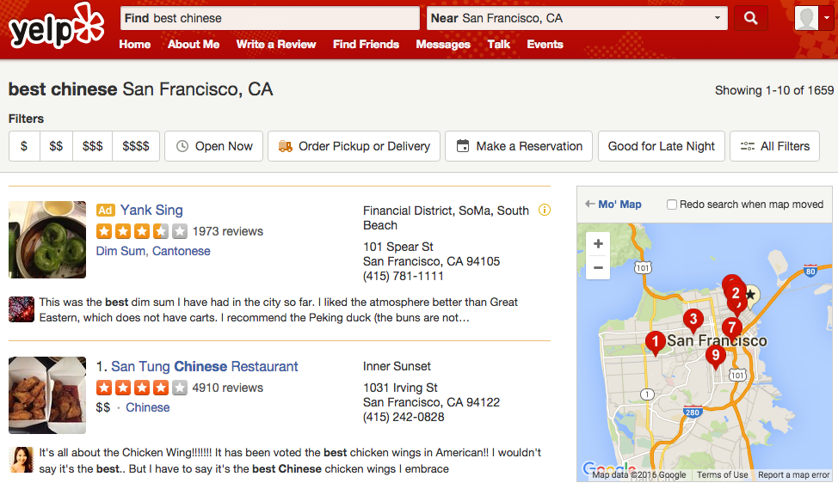
An Example - Authenticity

Slide 7
14% businesses reviewed users are within community
Notes:
Red Vertex and Edge= connection between Chinese Cuisine restaurant and any reviewer
Blue = connections between Other Cuisine restaurant and any reviewer
14% businesses reviewed users are within community (What is the average?)
Relatively dense structure

Slide 8
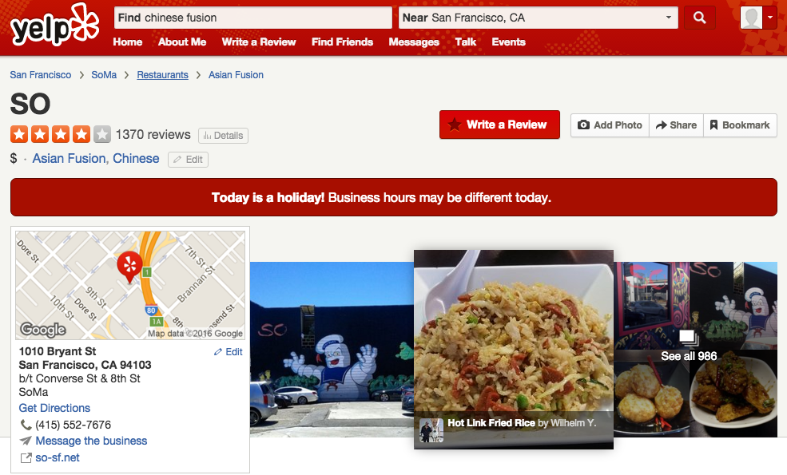

Slide 9
0.25% businesses reviewed users are within community
Notes:
0.25% within community connections
High Diversity
The strength of relationship user-business can be depicted by the length or transparency of lines
Closeness Centrality: -12% vs. Average
Each color represents a different community for this restaurant.
Restaurant is less diverse the the average because it has a lower centrality measure meaning its users are on average more different that average.
High volume of reviewers are eating at Chinese restaurants.
Conclusion: The combination of lower centrality and high Chinese volume suggests that this restaurant is likely more authentic than the average.

Slide 10
Conclusions
Notes:
Conclusions?

Slide 11
Other interesting tops to expand…
Cross-city
More reviewers
Non-elite reviewers
User-user connections
Look at menu and number of reviews per item, the more even distributed, the more authentic

Slide 12
Foodie Network Thank you!
GitHub Repo
LinkedIn
Alee7135@gmail.com

